Slide 1
K-Nearest Neighbour Session 19
Course : COMP6065001 Artificial Intelligence
Effective Period : September 2023

Slide 2
Learning Outcomes
At the end of this session, students will be able to:
LO 4: Apply various learning algorithms to solve the problems

Slide 3
Outline
Non-Parametric Model
Instance Based Learning
KNN
Exercise

Slide 4
Non-Parametric Model
Parametric model
A learning model that summarizes data with a set of parameters of fixed size
Linear regression & artificial neural network
Non-parametric model
One that cannot be characterized by a bounded set of parameters
K-nearest neighbors

Slide 5
Non-Parametric Model
For example, suppose that each hypothesis we generate simply retains within itself all of the training examples and uses all of them to predict the next example
It would be non-parametric solution (instance based learning or memory based learning)
The simplest instance based learning is
Table lookup

Slide 6
Table Lookup
Take all the training examples, put them in a lookup table, and then when asked for h(x), see if x is in the table
If it is, return the corresponding y
The problem with this method is that it does not generalize well: when x is not in the table all it can do is return some default value

Slide 7
Instance-Based Learning
We saw statistical learning as parameter learning, i.e., given a specific parameter-dependent family of probability models fit it to the data by tweaking parameters
Often simple and effective
Fixed complexity
Maybe good for very little data
Nonparametric learning methods allow hypothesis complexity to grow with the data
“The more data we have, the more ‘wigglier’ the hypothesis can be”

Slide 8
Instance-Based Learning
Nearest-Neighbor Method
Key idea : properties of an input point x are likely to be similar to points in the neighborhood of x
E.g. classification : estimate unknown class of x using classes of neighboring points
Simple, but how does one define what a neighborhood is?
One solution : find the k nearest neighbors
But now the problem is how to decide what nearest is...

Slide 9





K- Nearest Neighbors (KNN)
A method of classifying objects based on their similarity to their closest neighbors in the feature space.
Also called “Instance Based Learning/Lazy Learning”
K in K-NN refers to the number of the nearest neighbors to the object
K=1
K=3
K=5

Slide 10
How to Choose K?
To avoid ties, k is always chosen to be an odd number
Divide data and do Validation technique(ex: X-Val) with variety value of K
Why is it important to choose K wisely?
If K is too small, sensitive to noise points
If K is too large, neighborhood may include too many outliers from other classes

Slide 11
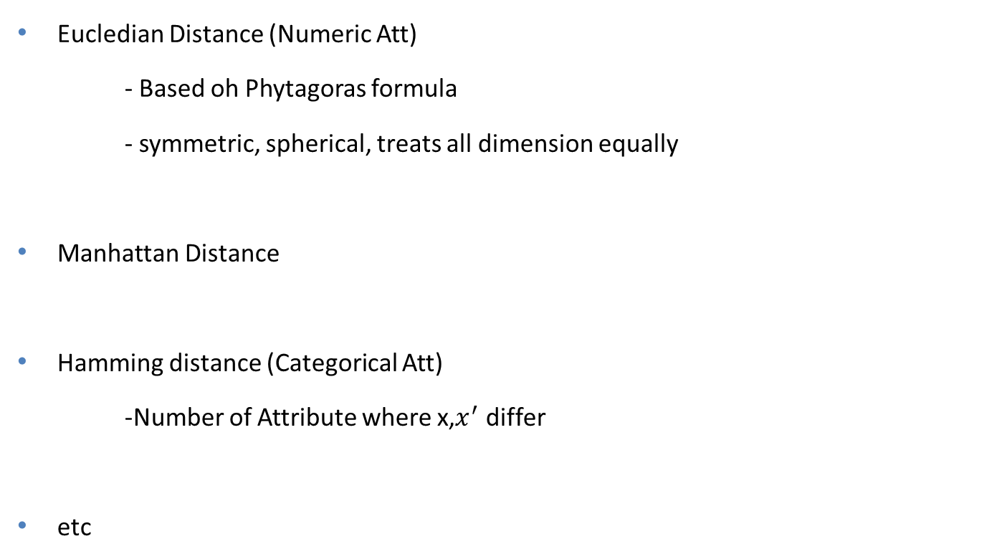
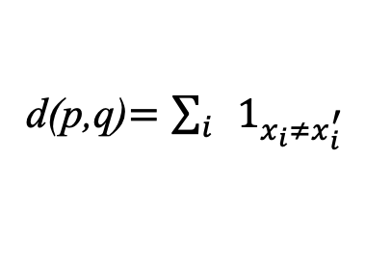
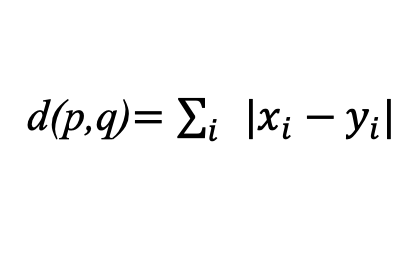
Distance Metric
Eucledian Distance (Numeric Att)
- Based oh Phytagoras formula
- symmetric, spherical, treats all dimension equally
Manhattan Distance
Hamming distance (Categorical Att)
-Number of Attribute where x,$x^{′}$ differ
etc
d(p,q)$=\sum_{i}{|x_{i}−y_{i}|}$
d(p,q)$=\sum_{i}{1_{x_{i}≠x_{i}^{′}}}$

Slide 12
The KNN Steps
Define K Value
Compute the distance between newVariable to all instance
Store the distance in a list and Sort
Choose the first K nearest Neigbors lables
Assign newVariable to the class which appears more frequently

Slide 13
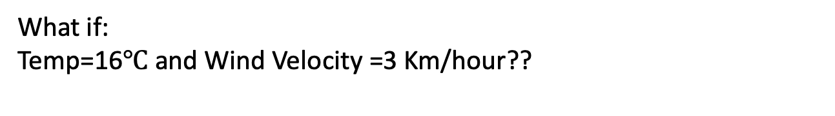
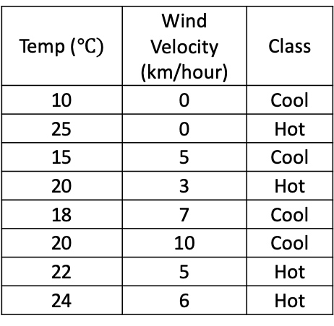
KNN Example
Given this data:
Temp ($℃)$ | Wind Velocity (km/hour) | Class
10 | 0 | Cool
25 | 0 | Hot
15 | 5 | Cool
20 | 3 | Hot
18 | 7 | Cool
20 | 10 | Cool
22 | 5 | Hot
24 | 6 | Hot
What if:
Temp=16$℃$ and Wind Velocity =3 Km/hour??

Slide 14
KNN Example
Here to solve:
Let say K=3
Count Distance of new object to all point.
?
Notes:
Eucledian distance: $\sqrt{{\left(x1−x2\right)}^{2}}+{\left(y1−y2\right)}^{2}$

Slide 15
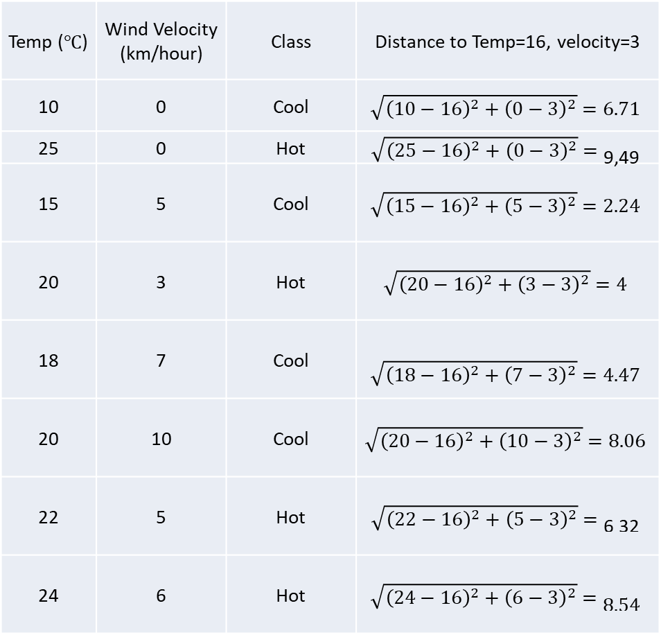
Temp (℃) | Wind Velocity (km/hour) | Class | Distance to Temp=16, velocity=3
10 | 0 | Cool | $$\sqrt{{\left(10−16\right)}^{2}+{\left(0−3\right)}^{2}}=6.71$$
25 | 0 | Hot | $$\sqrt{{\left(25−16\right)}^{2}+{\left(0−3\right)}^{2}}=\text{9,49}$$
15 | 5 | Cool | $$\sqrt{{\left(15−16\right)}^{2}+{\left(5−3\right)}^{2}}=2.24$$
20 | 3 | Hot | $$\sqrt{{\left(20−16\right)}^{2}+{\left(3−3\right)}^{2}}=4$$
18 | 7 | Cool | $$\sqrt{{\left(18−16\right)}^{2}+{\left(7−3\right)}^{2}}=4.47$$
20 | 10 | Cool | $$\sqrt{{\left(20−16\right)}^{2}+{\left(10−3\right)}^{2}}=8.06$$
22 | 5 | Hot | $$\sqrt{{\left(22−16\right)}^{2}+{\left(5−3\right)}^{2}}=\text{6}\text{.}\text{32}$$
24 | 6 | Hot | $$\sqrt{{\left(24−16\right)}^{2}+{\left(6−3\right)}^{2}}=\text{8.54}$$

Slide 16
KNN Example
Temp (℃) | Wind Velocity (km/hour) | Class | Distance to Temp=16, velocity=3
15 | 5 | Cool | 2,24
20 | 3 | Hot | 4
18 | 7 | Cool | 4,47
22 | 5 | Hot | 6,32
10 | 0 | Cool | 6,71
20 | 10 | Cool | 8,06
24 | 6 | Hot | 8,54
25 | 0 | Hot | 9,49
Here to solve:
Let say K=3
Count Distance of new object to all point.
Sort distance from the nearest to the farest
Choose the first 3 nearest neighbors
Assign new object to the class which appears more frequently
So, if Temperature= 16$℃$ and Wind Velocity =3 Km/hour then its “Cool”

Slide 17
KNN Example
?
Cool

Slide 18
Advantages of KNN
Simple and Easy to implement
No explicit training phase
New data can be added seamlessly, which will not impact the accuracy
KNN doesn’t make any assumptions about the data, meaning it can be used for a wide variety of problems.

Slide 19
Disadvantages of KNN
Hard to find best K
Sensitive to the noisy training data
Doesn’t work well in large dataset. The larger dataset the more Computation cost and slower the classification process become

Slide 20
KNN Application
Recommender system
Text Mining
Finance (loan management, bank customer profiling, etc)
Hospital and Medicine (cancer risk factor,etc )

Slide 21
References
Stuart Russell, Peter Norvig. 2010. Artificial Intelligence : A Modern Approach. Pearson Education. New Jersey. ISBN:9780132071482
https://www.cc.gatech.edu/~hays/compvision/lectures/17.pdf

